Slide 1
Nucleosides And Nucleotides: Structure, Function, And Biological Significance
Presented By:
T. Awinesh

Slide 2
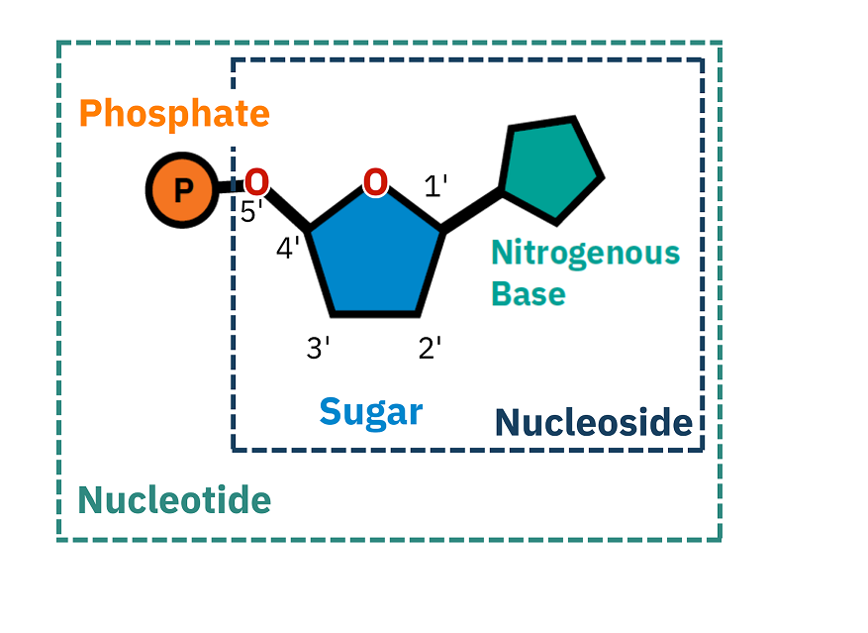
Introduction to Nucleosides and Nucleotides
Nucleosides and nucleotides are fundamental components of nucleic acids, which include DNA and RNA.
Nucleosides consist of a nitrogenous base and a sugar, while nucleotides include a phosphate group in addition to these.
Understanding their structure and function is crucial for comprehending genetic information storage and transfer.
Notes:
Image source: https://howmed.net

Slide 3
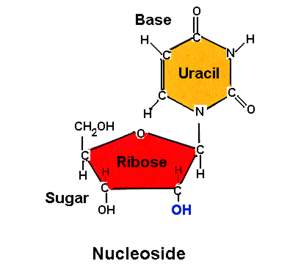
Structure of Nucleosides
Nucleosides are composed of two main parts: a pentose sugar (ribose or deoxyribose) and a nitrogenous base.
The nitrogenous base can be classified into two categories: purines (adenine, guanine) and pyrimidines (cytosine, thymine, uracil).
The glycosidic bond forms between the sugar and the nitrogenous base, creating the nucleoside structure.
Notes:
Image source: https://as2.ftcdn.net

Slide 4
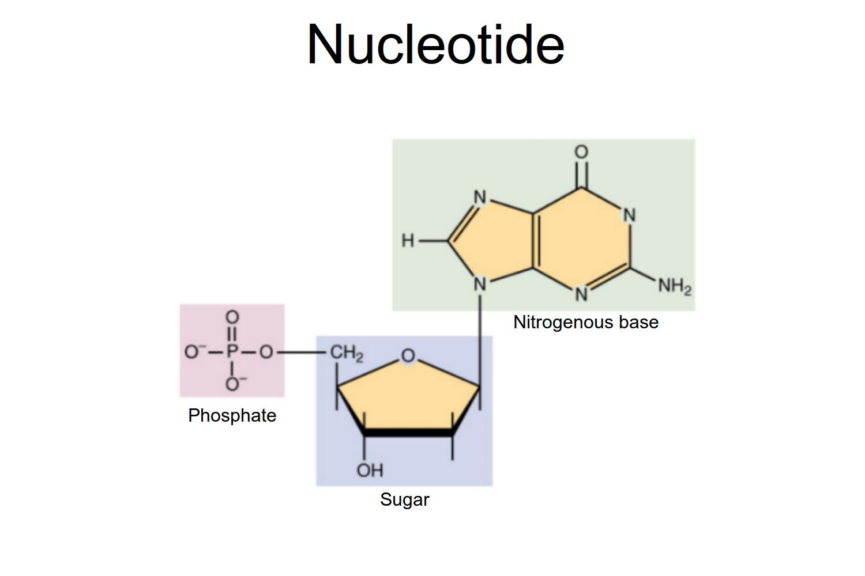
Structure of Nucleotides
Nucleotides consist of a nucleoside bound to one or more phosphate groups.
The phosphate group is attached to the 5' carbon of the sugar, forming a phosphoester bond.
Nucleotides can exist as mono-, di-, or triphosphates, influencing their role in cellular processes.
Notes:
Image source: https://www.researchgate.net

Slide 5
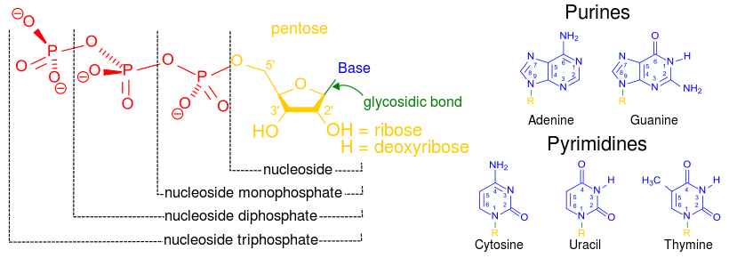
Notes:
Image source: https://www.researchgate.net

Slide 6
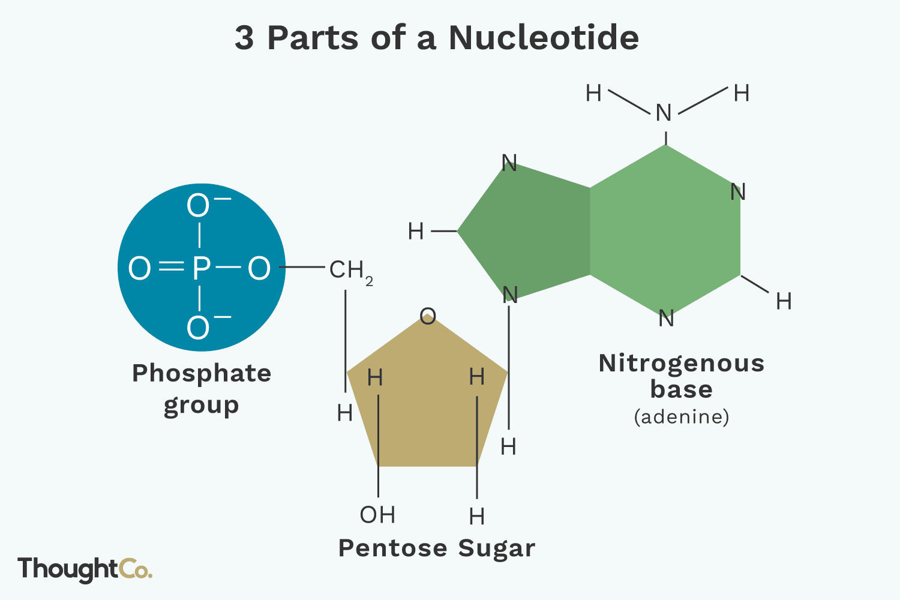
Functions of Nucleotides
Nucleotides serve as the building blocks of nucleic acids, essential for DNA and RNA synthesis.
They play critical roles in cellular energy transfer, particularly ATP, which is known as the energy currency of the cell.
Nucleotides also function as signaling molecules in various biochemical pathways, such as cyclic AMP in hormone signaling.
Notes:
Image source: https://www.slidemake.com

Slide 7
Role of Nucleosides in RNA
In RNA, nucleosides form the backbone that allows for the transmission of genetic information.
The presence of ribose makes RNA structurally distinct from DNA, contributing to its functional versatility.
Nucleosides such as adenosine can also act as signaling molecules in various physiological processes.
Notes:
Image source: https://www.alamy.com

Slide 8
Role of Nucleotides in DNA
Nucleotides are the fundamental units that make up the DNA double helix structure.
The arrangement of nucleotide sequences encodes genetic information necessary for organism development and function.
Phosphodiester bonds link nucleotides together, forming the sugar-phosphate backbone of DNA.
Notes:
Image source: https://s3-us-west-2.amazonaws.com

Slide 9
Biological Significance of Nucleosides
Nucleosides are involved in various metabolic pathways and can act as precursors to nucleotides.
They play roles in cellular signaling, influencing processes like cell division and apoptosis.
Nucleosides can also serve as therapeutic agents, such as antiviral and anticancer drugs.
Notes:
Image source: https://i.stack.imgur.com

Slide 10
Biological Significance of Nucleotides
Nucleotides are essential for energy metabolism and are critical substrates in the synthesis of nucleic acids.
They also participate in cellular signaling pathways, affecting processes such as muscle contraction and neurotransmission.
Deficiencies or imbalances in nucleotide metabolism can lead to various diseases and disorders.
Notes:
Image source: https://d1j63owfs0b5j3.cloudfront.net

Slide 11
Nucleoside and Nucleotide Analogues
Nucleoside and nucleotide analogues are modified versions that can inhibit nucleic acid synthesis, often used in drug development.
These analogues can help in treating viral infections, cancer, and other diseases by targeting specific metabolic pathways.
Understanding their mechanisms of action is crucial for improving therapeutic strategies.
Notes:
Image source: https://www.researchgate.net

Slide 12
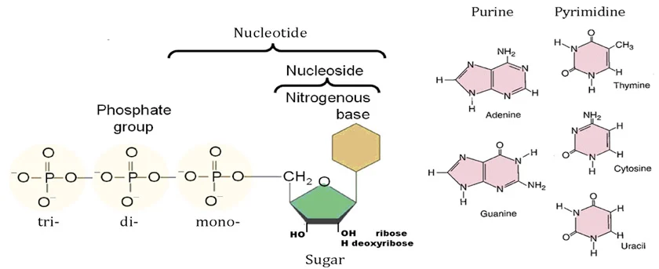
Conclusion
Nucleosides and nucleotides are vital for numerous biological processes, underpinning life at the molecular level.
Their roles in genetics, energy transfer, and signaling highlight their importance in both health and disease.
Future research on nucleosides and nucleotides may yield novel insights for therapeutic advancements.
Notes:
Image source: https://symeres.com

